Slide 1

Business Intelligence & Business Analytics BIBA
Topic 2
Enterprise Systems

Slide 2


Current RoadMap

Slide 3
Today
Enterprise Systems
Evolution – MRP, CL MRP, MRP II, ERP, ES Packages, Balanced Scorecard

Slide 4

Enterprise Systems
The Enterprise System (ES) is an information system that integrates business processes with the aim of creating value and reducing costs by making the right information available to the right people at the right time to help them make good decisions in managing resources proactively and productively.

Slide 5
ES-Enterprise Systems
Enterprise Systems are implemented as module applications
The aim is to support specific business process
Initially designed to bring about improved operational efficiency and effectiveness through integrating, streamlining, and improving fundamental back-office business processes.

Slide 6
The typical functions supported by Enterprise Systems
Accounting
Manufacturing
Human Resource Management
Purchasing
Inventory Management
Inbound Outbound Logistics
Marketing
Finance
Initially thought of as Back Office Systems
Justifiably so as they centered around process which didn’t involve the general public or the customer per say.

Slide 7
ES-Enterprise Systems
Newer Enterprise Systems have gone beyond back office to support front office process and activities.
E.g CRM
Customer relationship management (CRM) is a technology for managing all your company's relationships and interactions with customers and potential customers. The goal is simple: Improve business relationships.
A CRM system helps companies stay connected to customers, streamline processes, and improve profitability.

Slide 8

ES-Enterprise Systems
Customer Relationship Management is only one example of a typical ES.
CRM Examples include:
Inbound CRM: HubSpot CRM.
General CRM: Salesforce CRM.
Fully Integrated CRM: Freshsales.
Operational CRM: NetSuite CRM.
Sales CRM: Pipedrive
https://www.youtube.com/watch?v=dxxsS_dtf8s

Slide 9
Evolution of ES
ES have evolved from simple Material Requirement Planning (MRP) to ERP, Extended Enterprise Systems (ESS) and beyond.
The table of Evolution of ES ….

Slide 10
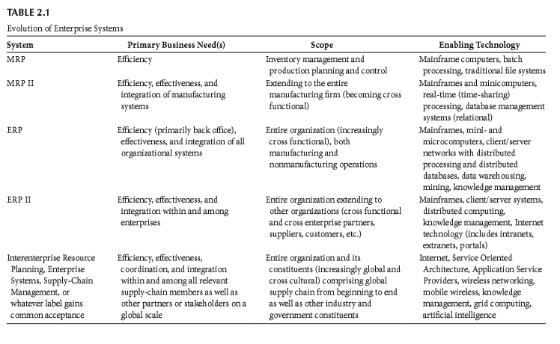
Evolution of ES (Vivek Kale, Enhancing Enterprise Intelligence:
Leveraging ERP, CRM, SCM, PLM, BPM, and BI (CRC Press).)

Slide 11
Materials Requirement Planning (MRP)
The first efforts in the ES field occurred at the beginning of the 1970s, when computerized applications based on MRP methods were developed to support purchasing and production scheduling activities.
Material requirements planning (MRP) is a production planning, scheduling, and inventory control system used to manage manufacturing processes.

Slide 12
The pillars of MRP Materials Requirements Planning
MRP is a heuristic* based on three main inputs:
The Master Production Schedule,
which specifies how many products are going to be produced during a period of time;
The Bill of Materials, which describes how those products are going to be built and what materials are going to be required;
The Inventory Record File, which reports how many products, components, and materials are held in-house.
*Enabling a person to discover or learn something for themselves.

Slide 13
Overview of the MRP System
The Bill of Materials
Master Production Schedule
Inventory Record File
MRP
Manufacturing Orders
Purchase Orders
Various Reports

Slide 14
Why MRP systems?
Ensure the availability of materials, components, and products for planned production and for customer delivery.
Maintain the lowest possible level of inventory
Plan manufacturing activities, delivery schedules, and purchasing activities.
MRP systems can detect when the due date of an order.

Slide 15
MRP Continue…
Can be easily programmed in any basic computerised application, at least in today’s standards, as it follows deterministic assumptions and a well-defined algorithm.
The initial primary objective of MRP was to compute material requirements, the MRP system proved also to be a useful scheduling tool.
Order placement and order delivery were planned by the MRP system.

Slide 16
MRP Continue…
As MRP systems became popular and more and more companies started using them, practitioners, vendors, and researchers started to realize that the data and information produced by the MRP system in the course of material requirements planning and production scheduling could be augmented with additional data and used for other purposes.

Slide 17
Evolution of MRP
MRP
Closed Loop MRP
MRP II
ERP

Slide 18
Closed-Loop Materials Requirement Planning (CL MRP)
An important evolution of MRP to add more capability.
Batch processing to time-sharing.
Became realistic partially due to the evolution of computers/computing power.
Provide almost real-time information for better planning and control.
allows plans to be checked against capacity to determine whether they are realistic and achievable.

Slide 19
CL MRP continue…
Production planning
Reflects the realities of the production floor, logistics, inventory and more.
Transformed MRP into a planning and control tool for manufacturing by closing loop.
Optimal use of manufacturing resources.
Everything comes with a cost!
No
Realistic?
Yes
Execute

Slide 20
Manufacturing Resource Planning (MRP II) not material planning
MRP had already evolved from a material requirements planning system into a planning and control system for resources in manufacturing operations.
MRP II is the next extension of MRP with more sophistication.
Databases started replacing traditional file systems.
This enabled better systems integration and greater query capabilities which lead to better decision making.

Slide 21
MRP II Goals
Goal: Plan and monitor all resources of a manufacturing firm (closed loop):
manufacturing
marketing
finance
engineering
Simulate the manufacturing system
Notes:
23
23

Slide 22
MRP Outputs: Primary
Planned orders
A schedule indicating the amount and timing of future
production and/or
purchasing orders

Slide 23
MRP Outputs: Secondary
Secondary Outputs
Performance-control reports
e.g., missed deliveries and stockouts
Planning reports
Data useful for assessing future material requirements
e.g., purchase commitments
Exception reports
excessive scrap rates,

Slide 24
MRP II continues …
Telecommunications network became an integral part of these systems.
Supports communications and coordination among system components that are geographically distributed.

Slide 25
Enterprise Resource Planning (ERP)
A computer system that integrates application programs in accounting, sales, manufacturing, and other functions in the firm
This integration is accomplished through a common database shared by all the application programs
Produces information in real time and ties in customers and suppliers

Slide 26
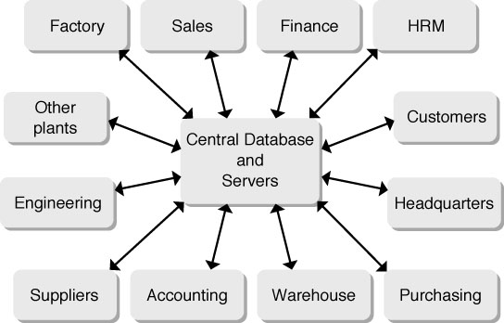
Typical ERP System

Slide 27
Enterprise Resource Planning (ERP)
ERP modules include
Basic MRP
Finance
Human resources
Supply chain management (SCM)
Customer relationship management (CRM)

Slide 28
Risks Associated with ERP Implementation
High Cost and Cost Overruns
Common areas with high costs:
Training
Testing and Integration
Database Conversion
Disruptions to Operations
ERP is reengineering--expect major changes in how business is done

Slide 29
ERP Products
SAP: largest ERP vendor
modules can be integrated or used alone
J.D. Edwards
flexibility: users can change features; less of a pre-set structure than SAP’s

Slide 30
ERP Products
Oracle
tailored to e-business focus
PeopleSoft
open, modular architecture allows rapid integration with existing systems
Baan
use of “best-of-class” applications

Slide 31
Leading ERP Vendors
SAP
Oracle
PeopleSoft
Sage
J.D.Edwards
Lawson
Microsoft Dynamics AX
Great Plains/Solomon
Invensys (BaaN)
IFS

Slide 32
Advantages of ERP Systems
Provides integration of the supply chain, production, and administration.
Creates commonality of databases.
Improves information quality.
May provide a strategic advantage.

Slide 33
ERP Drawbacks
Very expensive to purchase and even more so to customize.
Implementation may require major changes- Resistance to change .
So complex that many companies cannot adjust to it.
Involves an ongoing, possibly never completed, process for implementation.
Training is an on-going activity.

Slide 34
ERP in the Service Sector
ERP systems have been developed for health care, government, retail stores, hotels, and financial services
Also called efficient consumer response (ECR) systems
Objective is to tie sales to buying, inventory, logistics, and production

Slide 35
Balanced Scorecard (BSC)
A strategic planning and management system used to align business activities to the vision and strategy of the organization by monitoring performance against strategic goals.
Was first published in 1992 by Kaplan and Norton, a book followed in 1996.
Traditional performance measurement that only focus on external accounting data are obsolete.  The approach is to provide 'balance' to the financial perspective.

Slide 36
Why BSC?
Improve organizational performance by measuring what matters.
Increase focus on strategy and results.
Align organization strategy with workers on a day-to-day basis.
Focus on the drivers key to future performance.
Improve communication of the organization’s Vision and Strategy.
Prioritize Projects / Initiatives.

Slide 37
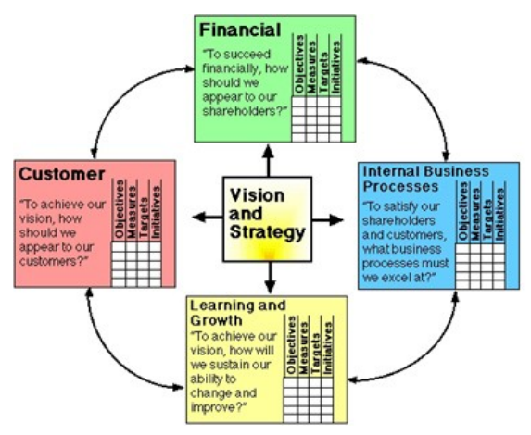
Balanced Scorecard (BSC)
The Balanced Scorecard model suggests that we view the organization from 4 perspectives.
Then Develop metrics, collect data and analyze it relative to each of these perspectives.

Slide 38
Balanced Scorecard (BSC)
Financial
What must we do to create sustainable economic value?
Internal Business Process
To satisfy our stakeholders, what must be our levels of productivity, efficiency, and quality?
Learning and Growth
How does our employee performance management system, including feedback to employees, support high performance?
Customer
What do our customers require from us and how are we doing according to those requirements?

Slide 39
References
Vivek Kale, Enhancing Enterprise Intelligence: Leveraging ERP, CRM, SCM, PLM, BPM, and BI (CRC Press).
Dr Manaz Kaleel PHD
Mr Sean Heeney
Pearson Education, Inc. publishing as Prentice Hall

